Slide 1

Lab: Data carpentry with Open Refine

Slide 2
Cleaning data
Data changes throughout its lifecycle
Different users & repositories have different needs
Data needs to be normalized, or standardized for analysis, publication and sharing
Excel is often no good for this!
Notes:
Say what normalized is
Talk about how normal it is to get data in Excel – and encourage them to work with excel – and think of this as something you can teach your clients

Slide 3
Open Refine
A powerful tool for manipulating and cleaning data
Looks like a spreadsheet (Excel), acts like a database
Great, free, open tool for data curation!

Slide 4
In this lab
We’ll learn:
The basics of Open Refine (w/ “What’s on the Menu”)
Creating a project, basic faceting and normalization
“What’s on the Menu” dataset
Reconciliation (w/ data from GBIF)
Introduction to linking to linked data
Publishing XML metadata with Refine (if we have time)

Slide 5
I. Open Refine Basics
Creating a New Project
Basic Normalization
Faceting and Clustering
Records vs. Rows
Advanced Transformations
Notes:
-- Note that it runs on desktop but opens in browser.
-- Demonstrate how to create a new project; how to do basic normalization; how to facet and cluster
-- Hands on exercise for 15 minutes (if there are advanced users, start a break-out discussion group)

Slide 6
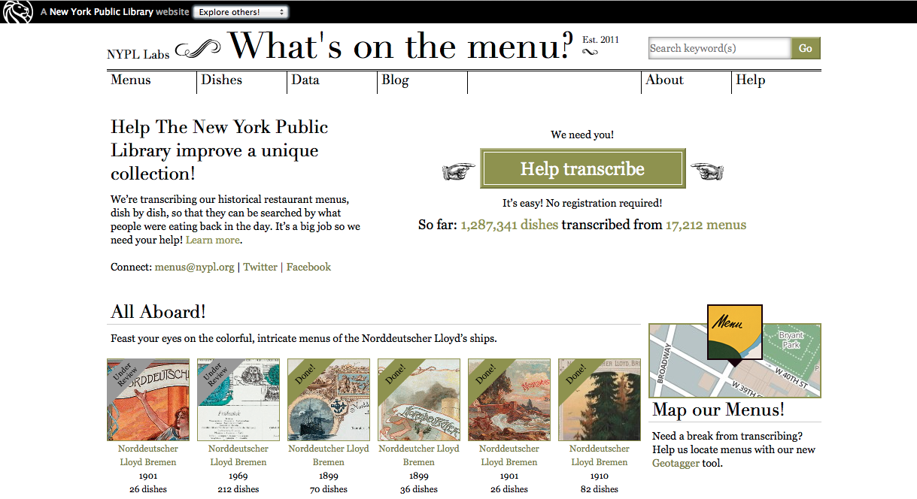
http://menus.nypl.org/
Notes:
-- NYPL has some 45,000 menus from 1840-present
-- Crowdsource project launched in April 2009
-- Creating a database of dishes

Slide 7


Crowdsourced transcription
Volunteer transcription can mean inconsistent data entry.
Even well-transcribed data needs cleaning (synonyms and spelling variants, etc.)
Changes over time:
vs.

Slide 8
Activity (10 minutes)
Step 1: Get to know “What’s on the menu?”
Browse menus: http://menus.nypl.org/
Try transcription and geo-tagging tools
Learn about your data access options
Step 2: NYPL menus data
Locate “NYPL Menus Data” folder on your desktop
Open “Menus.csv” or “Dish.csv” and review data
Step 3: Debrief

Slide 9
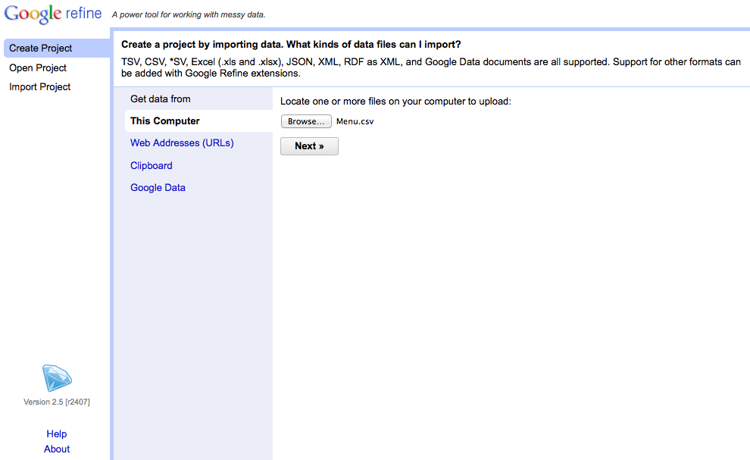
Creating a Project
Notes:
-- Choose create project (notice that you can also open projects you’ve worked on previously or import projects. The import feature is especially useful for collaboration)
-- Upload “Menu.csv”. Caveat: the other files are very large. It’s possible to allocate additional memory to Open Refine when working with large datasets, but not for the purposes of this demo. If this is important to you, we can discuss it during the hands-on session.

Slide 10
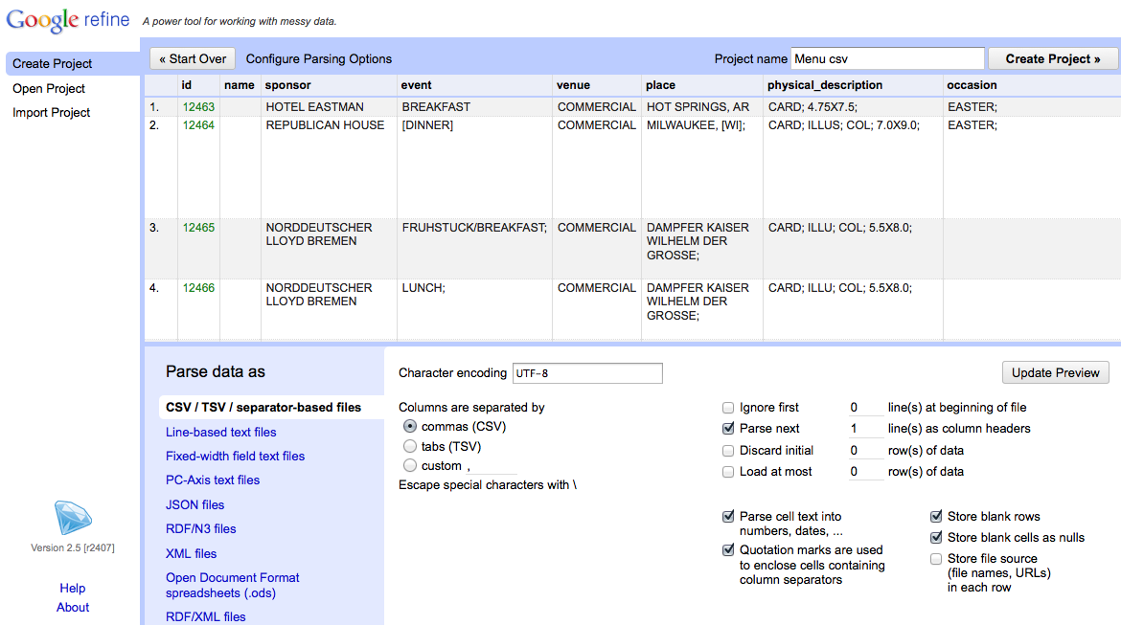
Creating a Project
Notes:
-- Use the preview window to review the data
-- Notice the parse options
-- for this data set, be sure that character encoding is UTF-8, Columns are set as CSV, and first line is parsed as a header
-- note quotation marks option. In this case, we have it checked, but it you use quotations in your data set for other purposes it may cause parsing issues
-- When you selected among options, click “update preview”, review again, and if all looks well, choose a project name and click “create project”

Slide 11
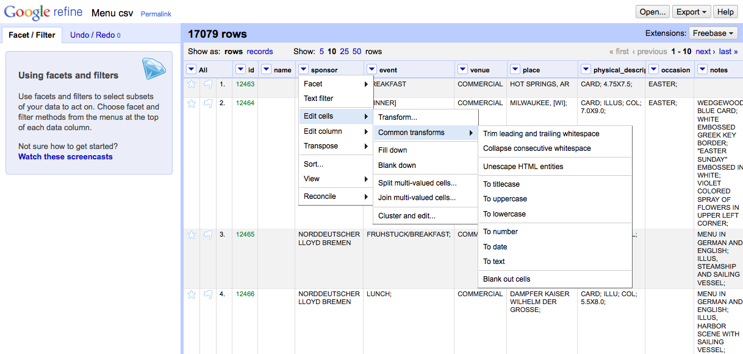
Basic Normalization
Notes:
-- click the arrow to the left of sponsor for a drop-down menu (notice the option your menu options)
-- choose edit cells
-- choose common transforms
-- start by trimming whitespace (you’ll notice that 14 cells were effected)
-- collapsing whitespace effects another 126 cells. Computers are better than humans at detecting white space.
-- also play with uniformly setting the cases

Slide 12
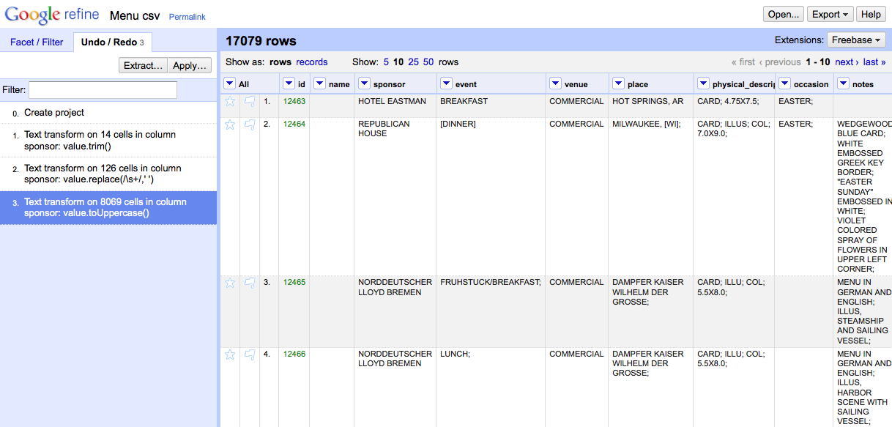
Tracking Project History
Don’t be afraid to make mistakes!
Notes:
Caveat: if you choose to navigate backward in your project history, you won’t be able to access any steps you’d taken after that point once you’ve made another change.

Slide 13
Extract and Apply!
Notes:
Note that you can extract your steps! This can save huge amounts of time for repetitive tasks

Slide 14
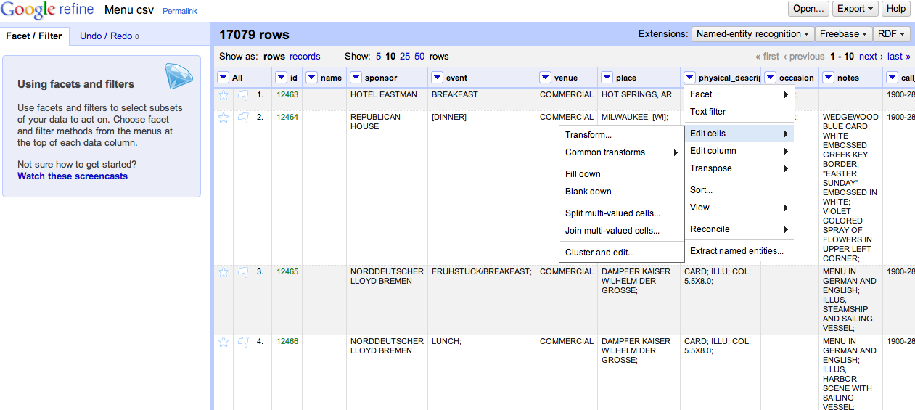
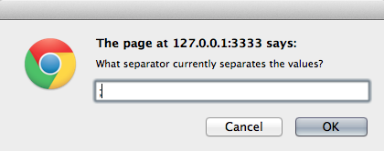
Records vs. Rows
Notes:
-- this likely won’t be needed today, but FYI: review the different between records and rows, beginning by splitting some multi-valued cells

Slide 15
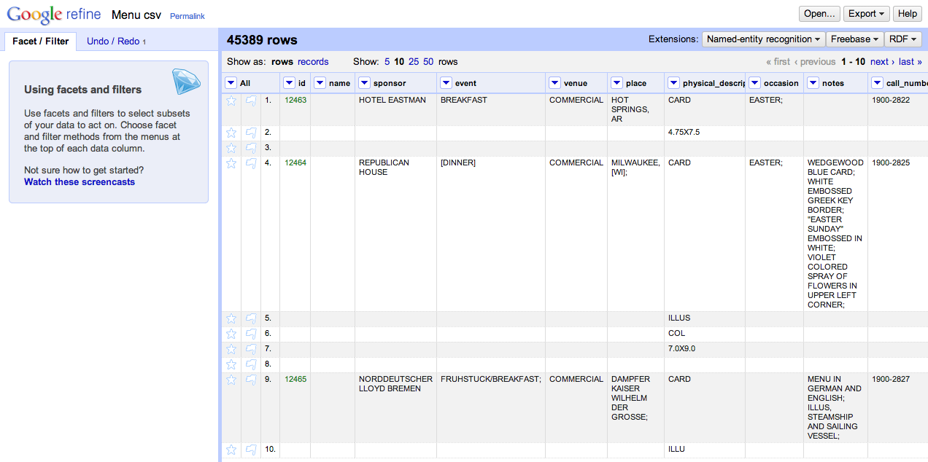
Multiple Values, Multiple Rows
Notes:
This is good if you’re only interested in specific values from the physical description, like whether or not menus are illustrated.
BUT, notice how the rest of rows 5, 6, and 7 are blank

Slide 16
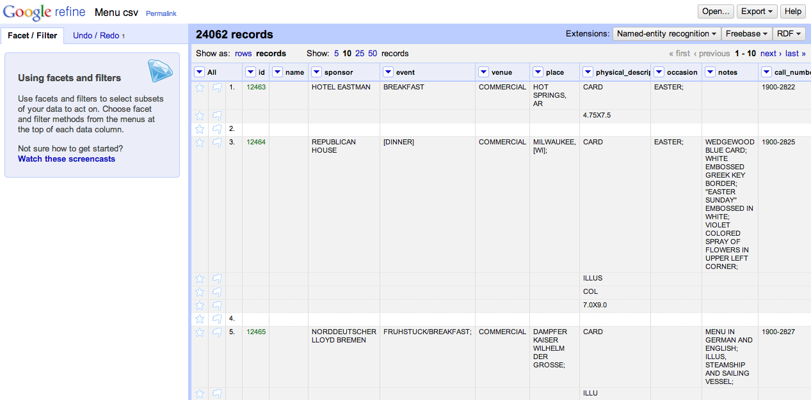
One Record, Multiple Rows
Notes:
Switching to the records view gives you the flexibility of gathering multiple rows together under the same ID.

Slide 17
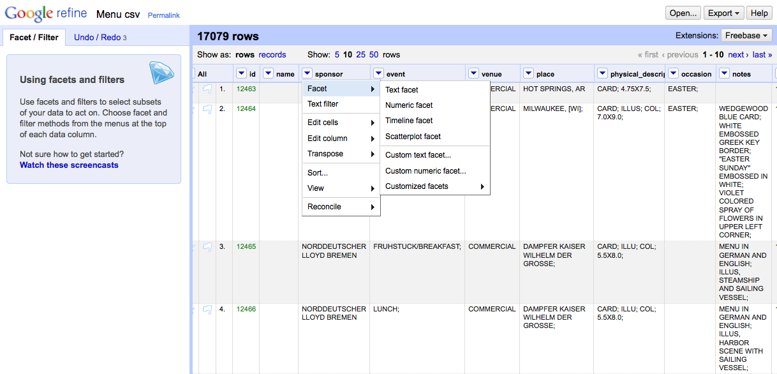
Faceting and Clustering
Notes:
-- Navigation to “Facet → Text facet”

Slide 18
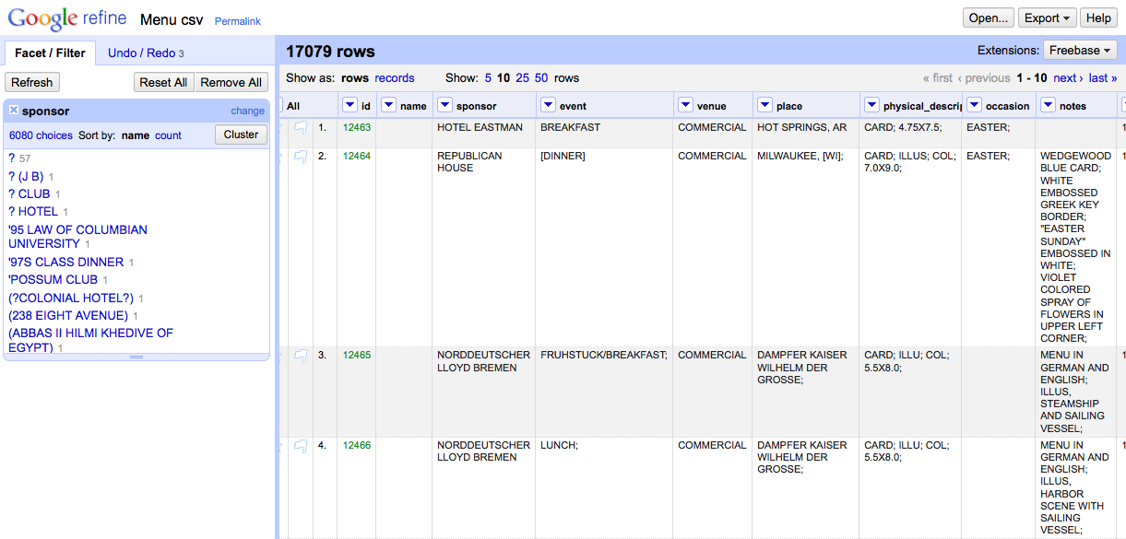
Faceting and Clustering
Notes:
-- Click “Cluster”

Slide 19
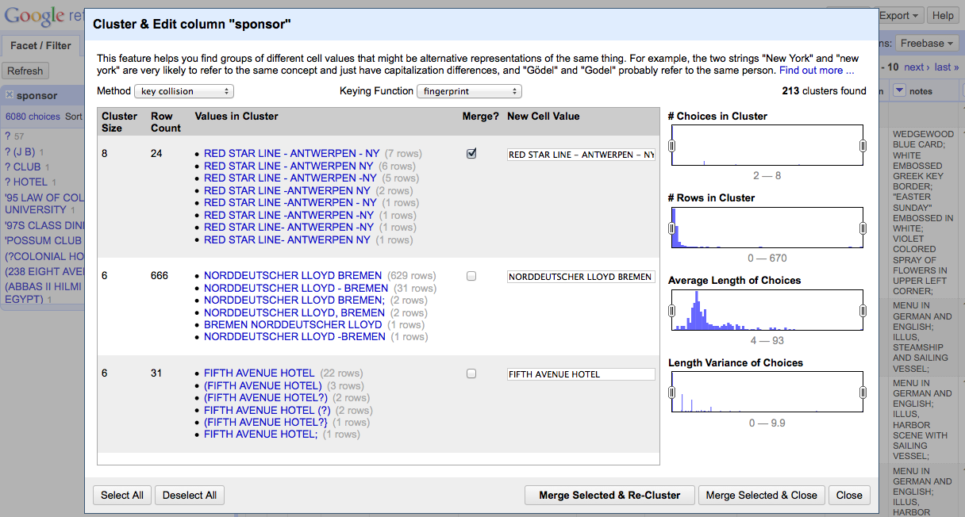
Faceting and Clustering
Notes:
-- For each cluster, review the values in the cluster, and (where needed) determine the preferred cell value.
-- Select the “Merge?” check box
-- Then select “Merge Selected and Re-Cluster”

Slide 20
Kinds of clustering
Key collision (fastest, safest)
Fingerprint, Ngram Fingerprint = defaults
Match normalized strings in different ways
Metaphone = English pronunciation
Nearest Neighbor
PPM = Partial matching
Levenshtein = edit distance

Slide 21
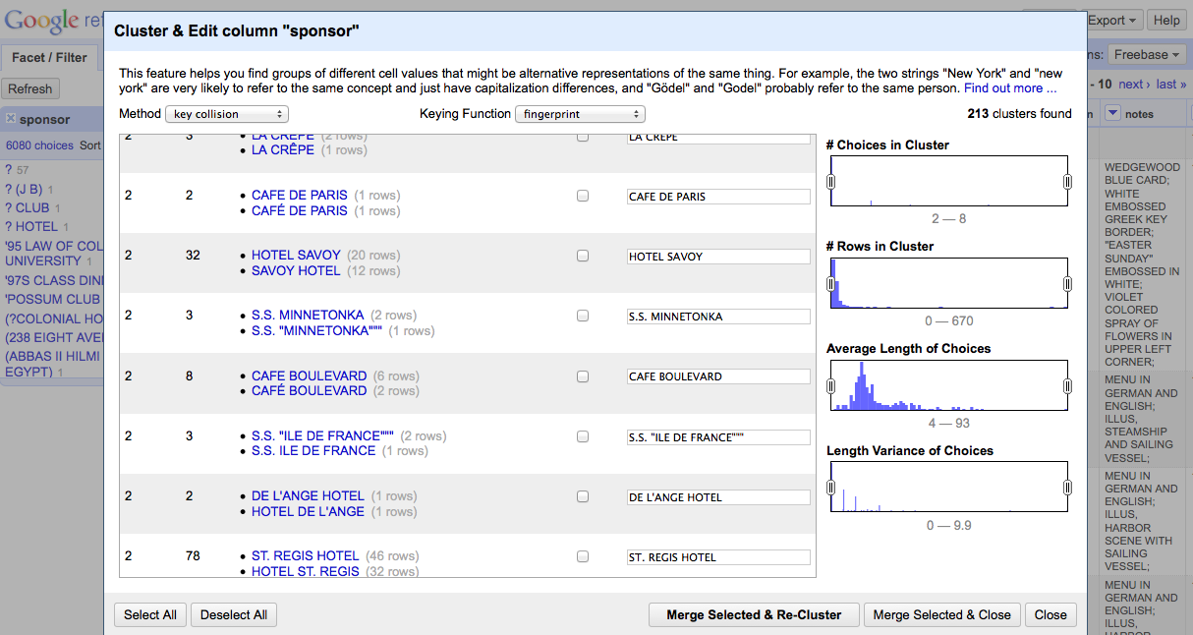
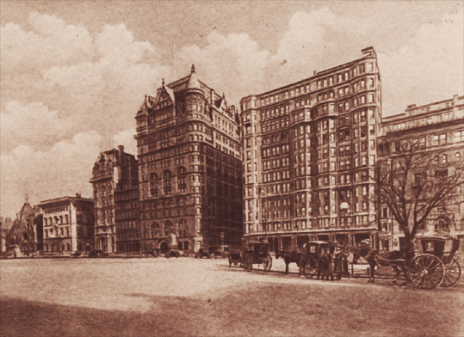
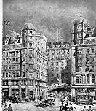
Check your clusters!
Hotel Savoy
59th St. & 5th Ave.
New York, New York
Savoy Hotel
Strand
London WC2R 0EU
United Kingdom
Notes:
Just because their names are similar doesn’t mean they’re the same!
-- Today the Hotel Savoy is an Apple Store. The Savoy Hotel is still in operation.

Slide 22
Activity: Explore Open Refine
Using the NYPL dataset, try clustering and cleaning your data
What transformations need to be made?
What clustering methods work best?
Try extracting your operations

Slide 23
II. Reconciliation
For this example, we’ll use the “biodiversity.txt” dataset
Reconciliation = comparing and correcting data fields according to a canonical list
Practice and build on prior activity!

Slide 24
First, clean the data (10 minutes)
Load “biodiversity.txt” into Open Refine
Take a moment to explore the data
Repeat the normalization steps from before (note: this is a pretty clean dataset, and many modifications may not be necessary)
What steps were necessary? What weren’t?

Slide 25
Name Reconciliation
“a semi-automated process of matching text names to database IDs (keys). This is semi-automated because in some cases, machine alone is not sufficient and human judgment is essential.”

Slide 26
Name Reconciliation
Used for:
Retroactively controlling a vocabulary
Creating linked data
Linking to and pulling additional data from a larger data store

Slide 27
Name Reconciliation
Used for:
Retroactively controlling a vocabulary
Creating linked data
Linking to and pulling additional data from a larger data store
From Rod Page’s iPhylo Blog
http://iphylo.blogspot.com/2012/02/using-google-refine-and-taxonomic.html

Slide 28
“scientificName” > Reconcile >”Start reconciling

Slide 29
Select “Add Namespaced Service; Pick a service from the list in your book

Slide 30
Start Reconciling!

Slide 31
It might take a while…

Slide 32
“scientificName” > Edit column > Add column based on this column

Slide 33
Expression: cell.recon.match.id

Slide 34
Done!

Slide 35
III. Open Refine for publishing XML-formatted metadata

Slide 36
Summary
Strengths:
Open source
Much more powerful than excel (some functions easier to use)
Platform independent
Great history tracking (provenance!)
Can export commonly used functions for reuse (more provenance!)
Notes:
Don’t neglect to get to this point and slide
Think about adding some more discussion poitns

Slide 37
Summary
Weaknesses:
Can be a little unstable; some queries are slow
Relies on many external services – some (Freebase) no longer supported
Some methods require light programming
More advanced functions are possibly biased toward English/Western languages (unfortunately a common problem in text processing)

Slide 38
Another example
Find the “locality” column
Use http://reconcile.freebaseapps.com/reconcile as the reconciliation service
Selection “location” as type, but note the many other services!
Reconcile away!

Slide 39
Georeferencing with Open Street Maps

Slide 40
Acknowledgments
This NYPL portion of this exercise was created at the Maryland Institute for Technology in the Humanities and developed through the Digital Humanities Data Curation Institute series, generously funded by the National Endowment of the Humanities.
Special thanks to Trevor Muñoz, Lydia Zvyaginsteva and Megan Senseney!

